Slide 1
Simple Network Management Protocol
Abhishek
Team PTC

Slide 2
Introduction
Name | Simple Network Management Protocol
Type | UDP
Port used | 161,162, 1161, 1162
Versions | v1, v2, v3 - latest
Common Misconfigurations | Sensitive info, RCE

Slide 3
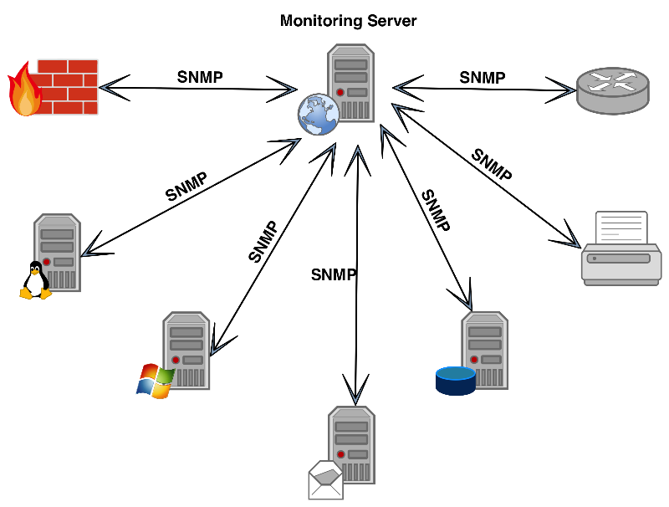
SNMP 101
If organization has 1000 devices in the network, to check all devices one by one is difficult, to ease this up SNMP is used

Slide 4
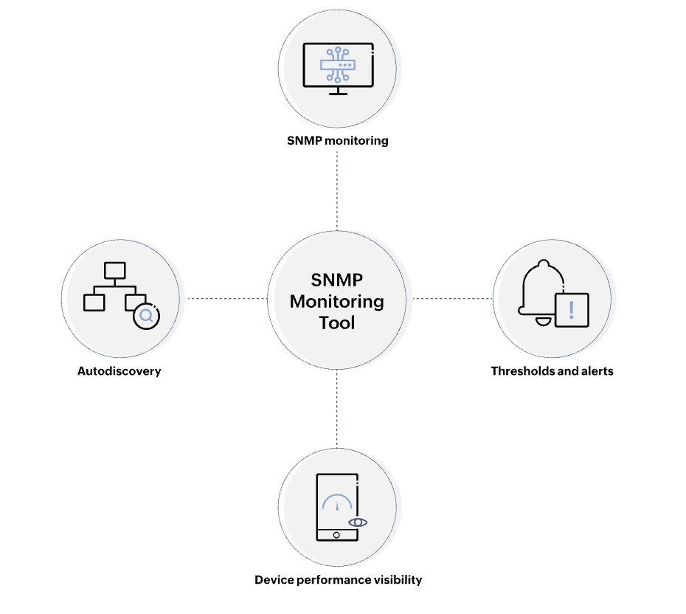
Why SNMP used?

Slide 5
Attributes of SNMP
Management Information Base - MIB is an independent format for storing device info.
Its a text file where we can query SNMP objects of device listed in tree hierarchy.
The OIDs(Object Identifiers) are designed to manage or represent the MIB objects

Slide 6
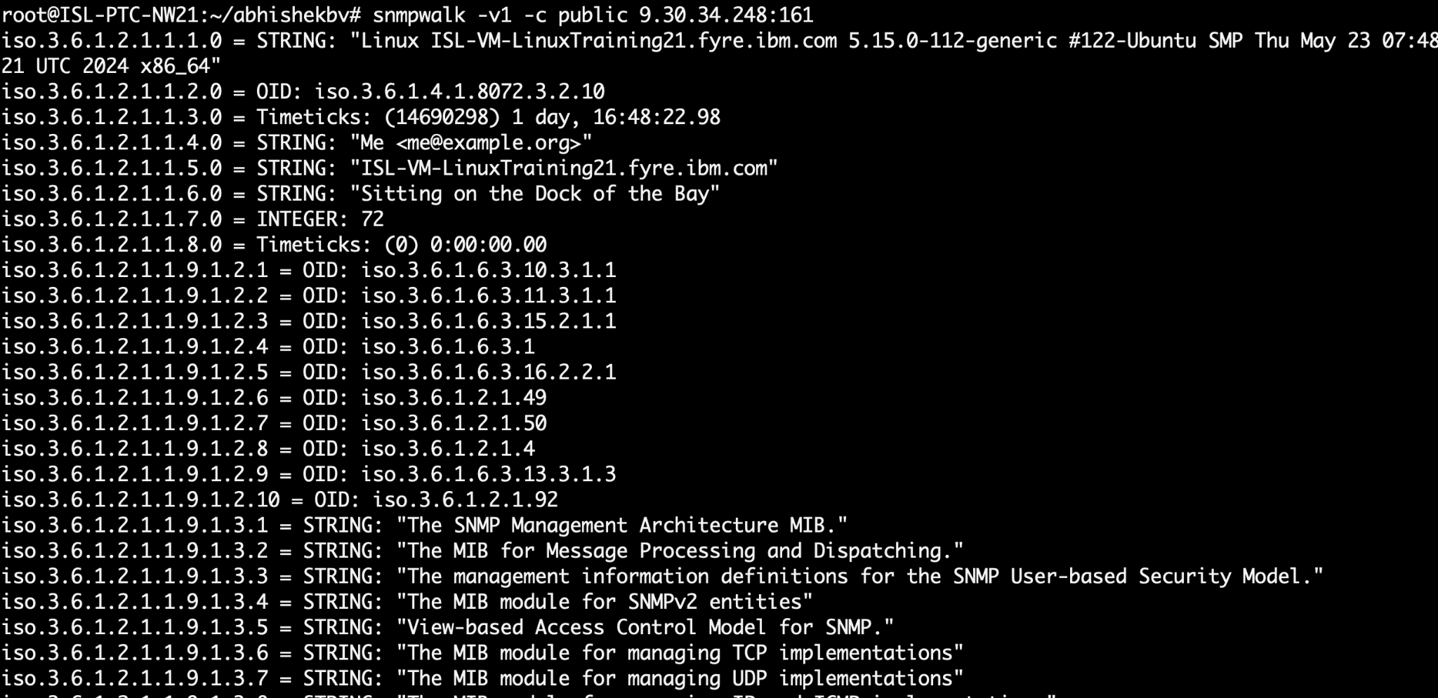
How they look like

Slide 7

It's not that Simple

Slide 8
SNMP Versions
SNMPv1: Authentication is based on a string that travels in plain text
SNMPv2: Sends text is plain text and uses a community string as authentication
SNMPv3: Uses a better authentication, information travelled is encrypted

Slide 9
SNMP Trap
SNMP trap is a type of message sent from snmp enabled device such as router, switch or server to an SNMP management station.
Purpose - SNMP traps are used to notify the SNMP manager about significant events or changes in device status such as reboot, hardware failure, threshold breach
Operation - When a predefined event occurs on device, it generates a message and sends it to SNMP manager. The SNMP manager then process and logs the trap and may trigger alerts based on information received
Example
trapcommunity public
trapsink 192.168.1.100
Trapcommunity public: sets the community string for traps
Trapsink 192.168.1.100: specifies IP address of SNMP manager

Slide 10
Attack Scenarios
Sensitive information disclosure
Exploit Read Write access
SNMP Set Vulnerability
RCE

Slide 11
Defense
Two main settings enable access to full OID tree.
Rwuser noauth - permits full access to OID tree without the need for authentication
For more specific control
Rwcommunity
Rwcommunity6
Check for logs

Slide 12
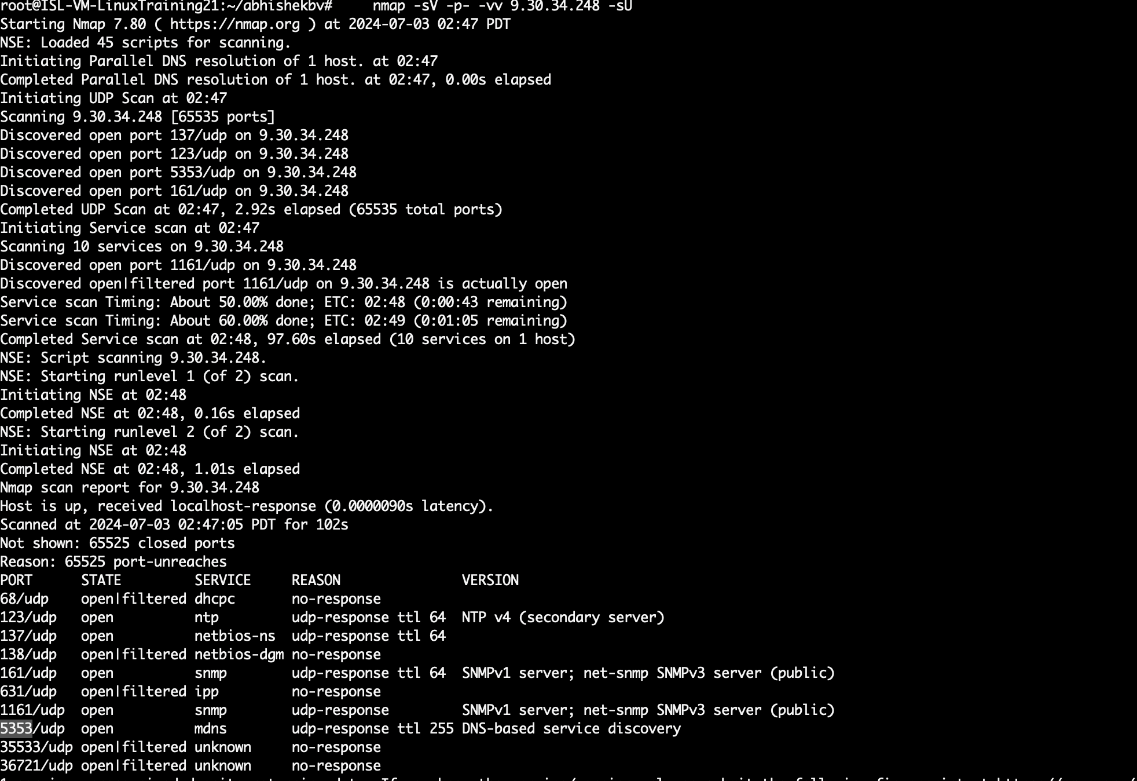
Nmap result

Slide 13

Demo
https://github.com/bvabhishek/snmp-goat/blob/main/README.md

Slide 14
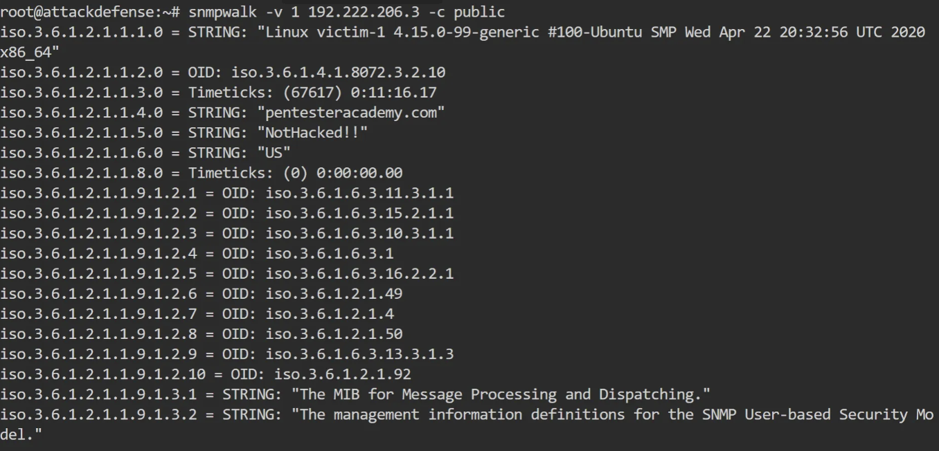
SET SNMP vulnerability
snmpwalk -v 1 192.222.206.3 -c public

Slide 15
snmpwalk -c public 192.222.206.3 -v1 -On | grep ‘.1.3.6.1.2.1.1.5.0’
Rewrite the sysName using snmpset
snmpset -v 1 -c public 192.222.206.3 ‘.1.3.6.1.2.1.1.5.0’ s AttackDefenseLabs

Slide 16
Verify
snmpwalk -c public 192.222.206.3 -v1 -On | grep ‘.1.3.6.1.2.1.1.5.0’

Slide 17
Best Practices
Disable SNMP on hosts when not in use
Change the default SNMP community read string
Block SNMP traffic to ports 161, 162
If attackers know the app is using SNMP then they may try to reconfigure or disrupt service
Use a firewall or regularly monitor traffic to watch out for malicious activity
Restrict access to snmp devices
User SNMP V3 as it is safe and encrypted

Slide 18
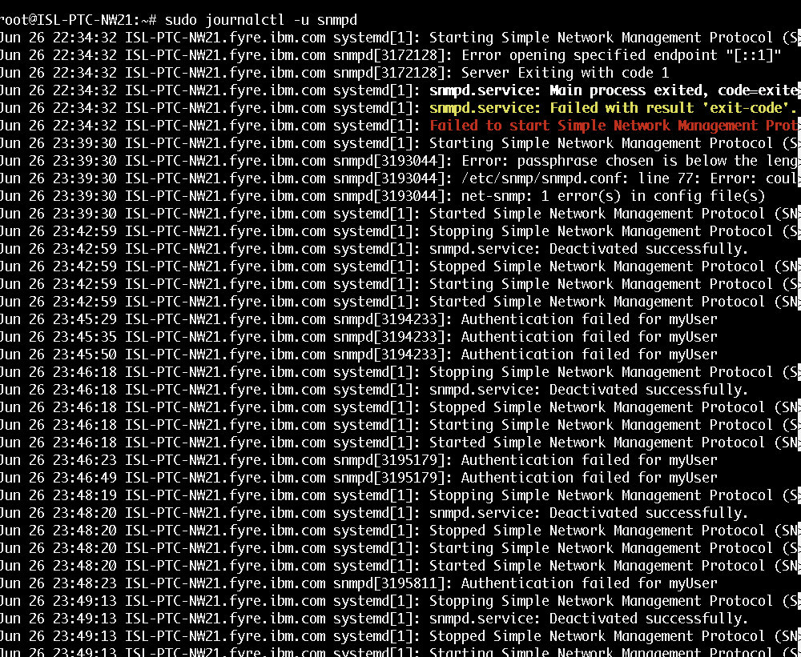
SNMP logs

Slide 19
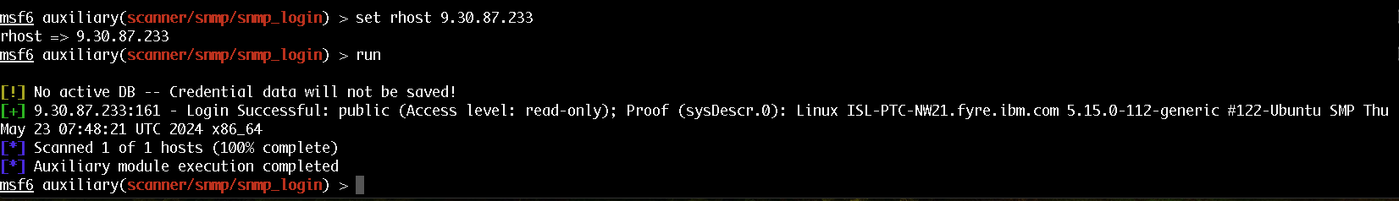
Msfconsole

Slide 20
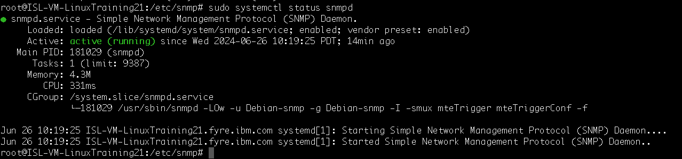
Some more POC
Check SNMP Status

Slide 21
Some more on RCE
RCE - https://hacktricks.boitatech.com.br/pentesting/pentesting-snmp/snmp-rce

